Slide 1

Carbon Footprint
(CSP-Cloud Service Provider)

Slide 2
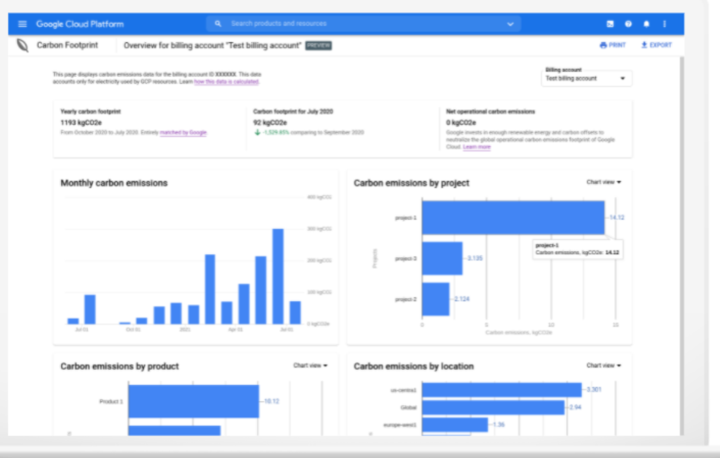

Google Corban Footprint Dashboard
The dashboard displays a summary of the data to provide you with a high-level overview of the gross estimated greenhouse gas emissions associated with the usage of covered Google Cloud services for the selected billing account.
Notes:
https://www.youtube.com/watch?v=Aso72AHE8Yg&list=RDCMUCJS9pqu9BzkAMNTmzNMNhvg&start_radio=1

Slide 3
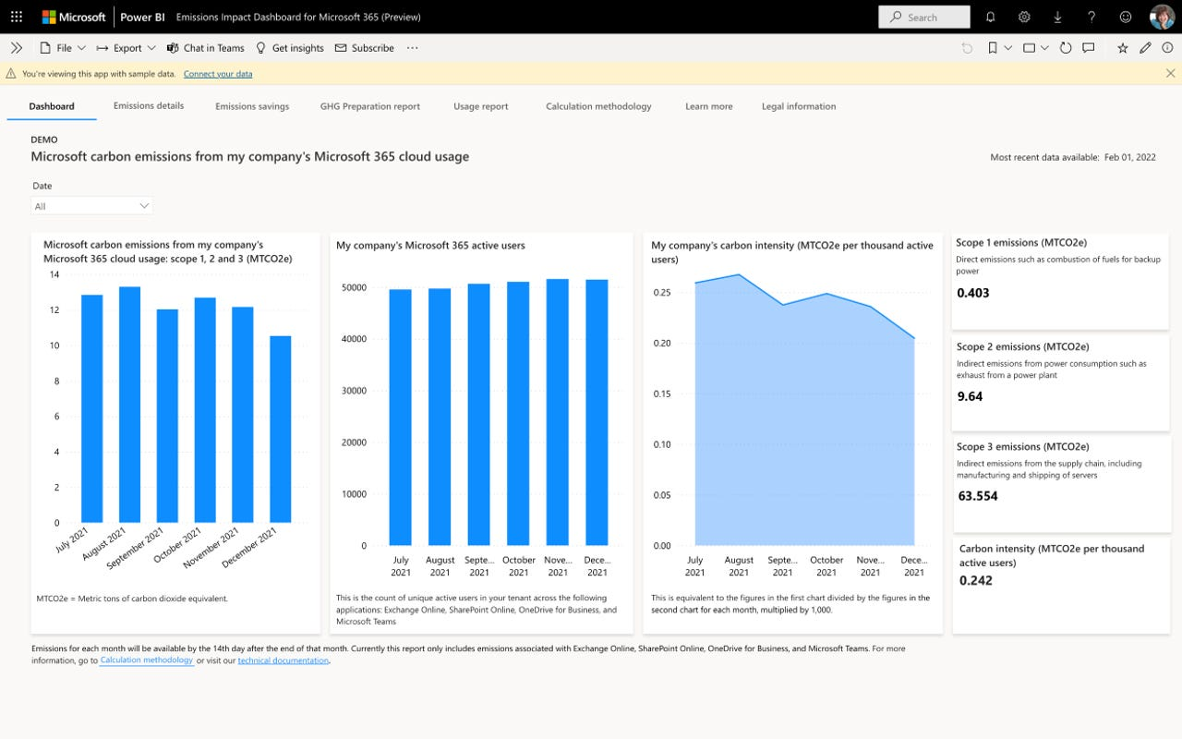



Emissions Impact Dashboard for Azure
The Emissions Impact Dashboard provides our cloud customers with transparency into their greenhouse gas emissions associated with cloud usage. Our Generally Available version and is available for anyone to download.
Requirements for getting started
The Emissions Impact Dashboard runs on Power BI Pro. Get the Power BI Pro free trial.
The Emissions Impact Dashboard can support EA, Microsoft Customer Agreement, and CSP for Azure customers. Enrollment ID or Billing Account ID, each with Admin access, is required to connect your company data to the calculator. For more info on how to connect the calculator, visit this site.
Notes:
https://www.youtube.com/watch?v=Aso72AHE8Yg&list=RDCMUCJS9pqu9BzkAMNTmzNMNhvg&start_radio=1

Slide 4
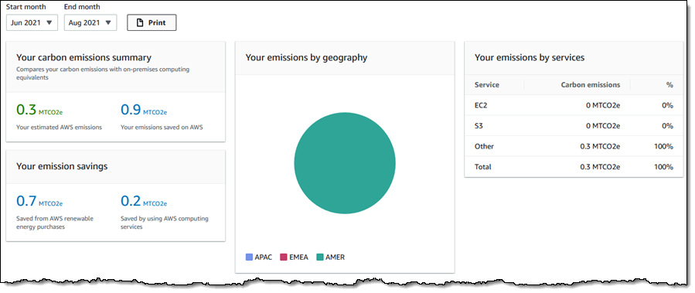

AWS Customer Carbon Footprint Tool
Customers need to accurately measure the carbon emissions associated with Using AWS services
AWS Carbon Footprint Tool calculates Carbon footprint of workloads hosted on AWS using GreenHouseGas Protocol
Review and report on carbon emissions associated with your usage of AWS Services with easy-to-understand data visualization
Notes:
https://www.youtube.com/watch?v=Aso72AHE8Yg&list=RDCMUCJS9pqu9BzkAMNTmzNMNhvg&start_radio=1

